Slide 1
Class 2DC2DD Group 21 SPRINT 4
Group members:
Bárbara Pinto (1191507)
Carlos Dias (1200991)
Cristóvão Sampaio (1201029)
Miguel Silva (1201045)
Martim Maciel (1201154)

Slide 2
Sprint planning – Sprint 4
Planned Start Date: Jan. 4th Real Start Date: Jan. 4th
Planned Finished Date: Jan. 23rd Real Finish Date: Jan. 23rd
SPRINT BACKLOG
Number of stories | 20
Number of bugs | 00
Number of tasks | 67
Number of Management Tasks | 07
Number of team members | Planned: 5 Actual: 5
Total planned estimation vs execution | Planned hours: 4w 1h Executed hours: 3w 2d 4h

Slide 3
Sprint planning
Assignment US | Commited? | Todo | Doing | Testing | Done | Blocked
US401 | Yes |  |  |  | x
US402 | Yes |  |  |  | x
US403 | Yes |  |  |  | x
US404 | Yes |  |  |  | x
US405 | Yes |  |  |  | x
US406 | Yes |  |  |  | x
US407 | Yes |  |  |  | x
US408 | No
US409 | Yes |  |  |  | x
US410 | Yes |  |  |  | x
US411 | No

Slide 4
Sprint planning
Assignment US | Commited? | Todo | Doing | Testing | Done | Blocked
US412 | Yes |  |  |  | x
US413 | Yes |  |  |  | x
US414 | Yes |  |  |  | x
US415 | Yes |  |  |  | x
US416 | Yes |  |  |  | x
US417 | Yes |  |  |  | x
US418 | Yes |  |  |  | x
US419 | Yes |  |  |  | x
US420 | Yes |  |  |  | x

Slide 5
Sprint Execution
Issues | Sprint Backlog (a) | Added issues during sprint (b) | Closed issues from initial planning (c) | Closed issues from added ones (d) | Issues not closed (e) | % Execution
 |  |  |  |  |  | Planned (c/a) | Total (c+d)/(a+b)
Number of stories (I) | 20 | 0 | 19 | 0 | 1 | 95 | 95
Number of bugs (II) | 117 | 43 | 0 | 23 | 20 | 0 | 14,4
Number of tasks (III) | 57 | 10 | 57 | 10 | 0 | 100 | 100
TOTAL | 143 | 98 | 78 | 45 | 54 | 65 | 69,8
Total Estimate | 4w 1h

Slide 6
Work by team member

Slide 7
Work by type
Notes:
“Era interessantes inventarem componentes, tais como gestão a 15%”
7

Slide 8
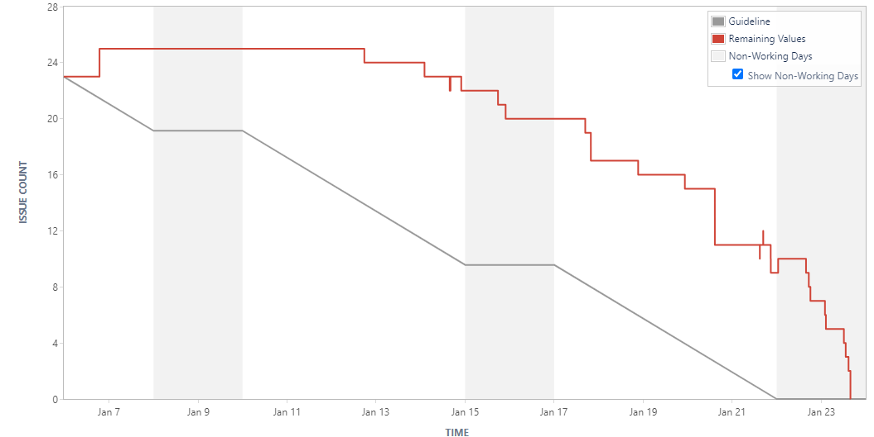
Sprint Burndown Chart

Slide 9
Sprint Review
Date: 23 jan. 2022
Main conclusions
From implemented functionalities:
Successfully implemented several new methods to calculate paths between locations.
Successfully implemented container loading insights for ships with various layouts, considering balancing issues of the vessel.
Successfully computed energy comsumption of containers and ships.
Successfully implemented several resource management functionalities using data from database.
Resolved pending issue of linking authenticated users with data viewing permissions.

Slide 10
Sprint Retrospective
Date: 23 jan. 2022
What went well?
User Story dependencies were well determined.
User Story estimation was accurate, leaving extra time for reviews.
Excellent team work and shared knowledge.
Faster task execution time, as the result of the solid foundation developed in Sprint 1 and previous experience.
Improvements to backlog, with higher comment activity, issue detailing and subtask creation.
What went wrong?
Sprint assessment spanned several weeks of PL classes and restricted interaction with the teachers.
Course assessments (e.g. ARQCP) at the beginning of the sprint delayed work quite a bit.
What we’ve learned?
In future developments, tasks and time should be reserved for code quality analysis and improvement.
Project burndown cannot always be linear, especially when considering study needs for exams.
Database structure must be reviewed very early in the sprint.

Slide 11
Sprint Retrospective
Date: 23 jan. 2022
Action items:
Project Management:
Create database review subtask at the beginning of the sprint.
Create code quality review subtask at the beginning of the sprint.
Notes:
11

Slide 12
Team performance metrics
Notes:
“Registar os vários burndowns de várias sprints para ver se há padrões”, “ Ver se a velocidade tá a aumentar, diminuir, ou é constante”
12

Slide 13
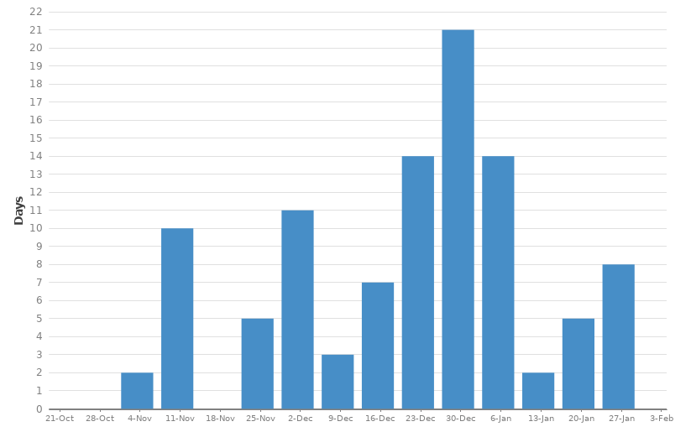
Team performance metrics
Resolution Time Report
Notes:
“Registar os vários burndowns de várias sprints para ver se há padrões”, “ Ver se a velocidade tá a aumentar, diminuir, ou é constante”
13

